Slide 1


School of
Computer Science
Minor Project 2- Final Presentation
TITLE:
BUDGET BASKET-
E-COMMERCE PLATFORM

Slide 2

Project Mentor
Project Team
Dr. Dhinesh Kumar
ROLL NO. | NAME | SAP ID | BATCH
R2142221208 | ROSHITA AILAWADI | 500105016 | B-3 DATA SCI. (NH)
R2142221162 | SOMYA YADAV | 500108000 | B-1 DATA SCI. (HONS.)
R2142221397 | ZAIRA KHAN | 500110143 | B-3 DATA SCI. (NH)
R2142221204 | MANAS ARORA | 500109627 | B-5 AIML(NH)

Slide 3

INTRODUCTION
•Grocery prices vary across stores, leading to overspending.
•Existing solutions focus on electronics, not groceries.
• Our platform aggregates, analyzes, and presents grocery prices in real-time.
• Users can track price trends and receive recommendations.

Slide 4
PROBLEM STATEMENT
• Consumers lack real-time grocery price tracking.
• Price disparities make budgeting difficult.
•No single platform consolidates grocery pricing data efficiently.
•This project develops a centralized system for real-time grocery price comparisons.

Slide 5
OBJECTIVES
The primary objectives of this project are:
Provide users with real-time grocery price comparisons.
Predict price trends to help users shop at optimal times.
Enhance decision-making with personalized recommendations.

Slide 6
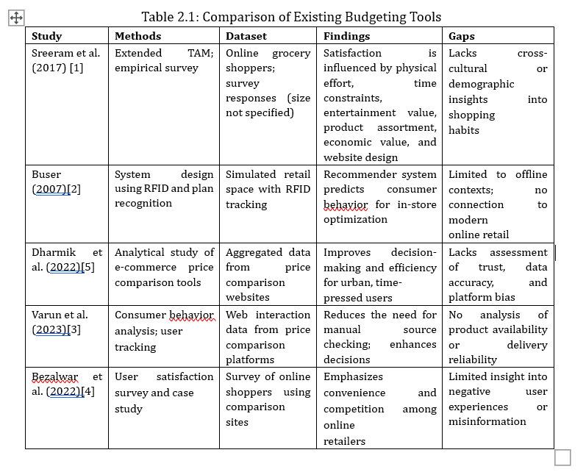
Literature Review

Slide 7
METHODOLOGY
Data collection
Data pre-processing
Price comparison algorithm
Algorithm optimization
Product availability tracking
Price prediction using previous trends
Data visualization for consumer insights
System Architecture
Testing and deployement

Slide 8
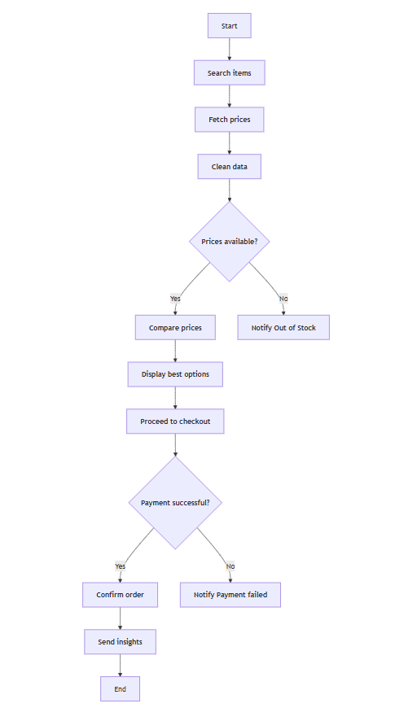
WORK FLOW

Slide 9
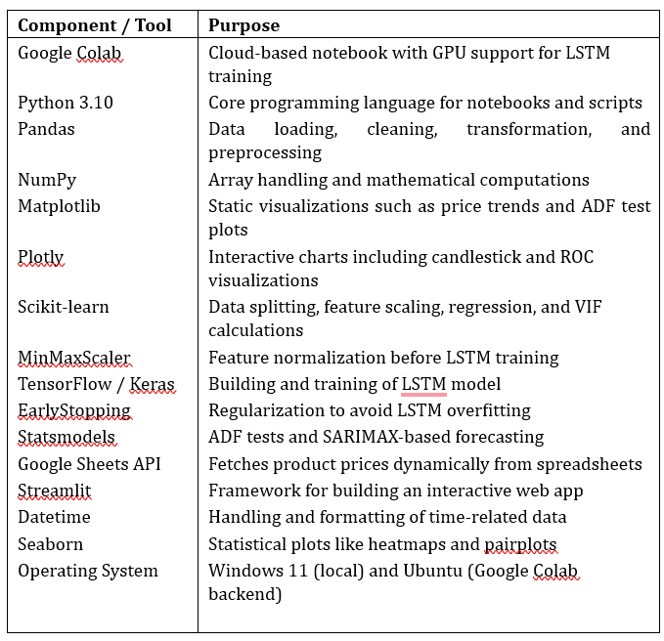
Techniques Used

Slide 10
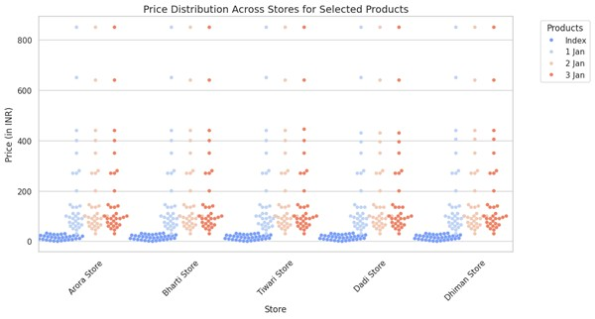

Results
The study reveals that Store B offers the cheapest prices for most-granular and finer grains. It is the most amenable for sustenance shopping. Interestingly, Store C has been rated higher in the oil section, which may be due to supplier contracts and/or promotions. These factors may sway consumer choices and inform store-level pricing.
Figure: Price Distribution Across Stores for Selected Products

Slide 11
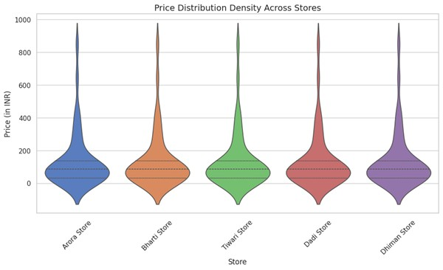
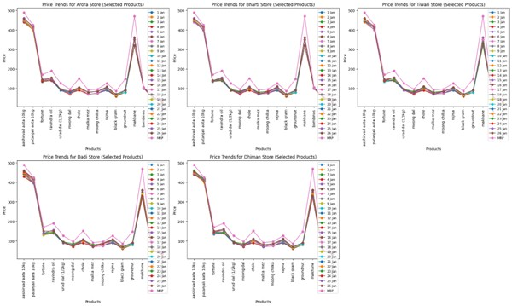
Figure: Price Distribution Density Across Stores
Figure: Price Trends for Store Name for Selected Products

Slide 12
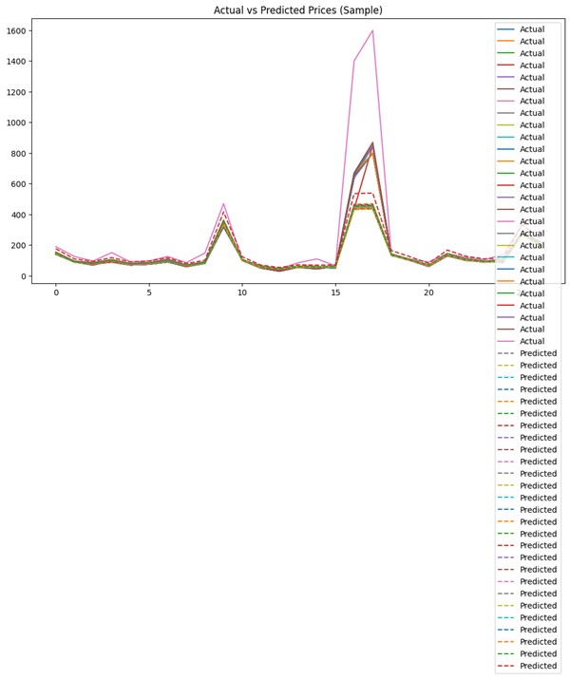
Figure: Actual vs Predicted Prices (Sample)

Slide 13
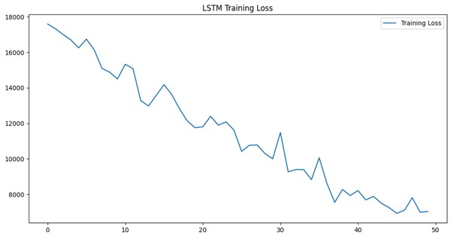
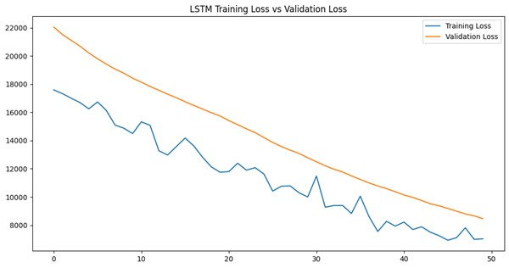
Figure: LSTM Training Loss vs Validation Loss
Figure: LSTM Training Loss

Slide 14
PERT CHART
SYNOPSIS PRESENTATION
MID SEM PRESENTATION
END SEM PRESENTATION
Data collection
Data preprocessing
Algorithm optimaztion
Data visualization
System optimazation
Testing and deployment

Slide 15
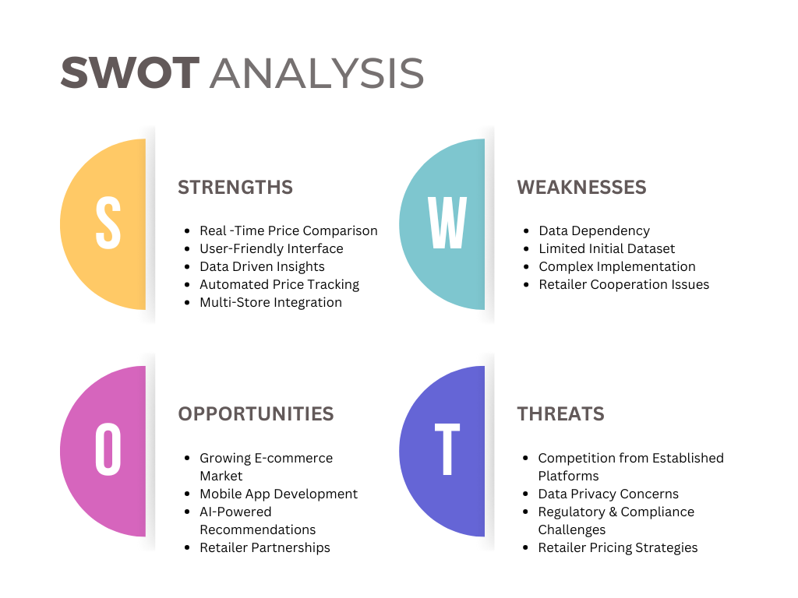

Slide 16
Areas Of Application
•Grocery Shopping: Compare prices across supermarkets.
•E-commerce: Integration with online retailers.
• Financial Planning: Helps users budget effectively.
• Retail Strategy: Assists stores in monitoring competitor pricing.

Slide 17
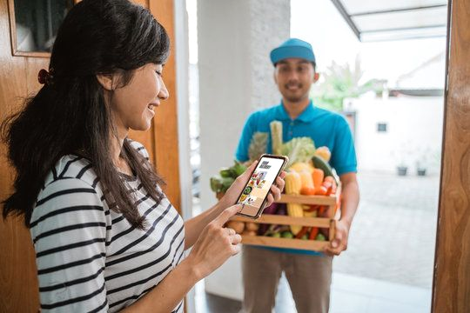
CONCLUSION
Streamlined Shopping: Combines product information and price comparisons in one platform.
Scalability: Expandable beyond groceries to clothing, electronics, and more.
Personalized Discounts: Uses spending analytics to offer tailored deals.
Enhanced User Engagement: Provides better recommendations based on past shopping behavior.

Slide 18
REFERENCES
[1] Sreeram, A., Kesharwani, A., Desai, S.: A combined model of online grocery buying intentions based on the Technology Acceptance Model. J. Retail. Technol. 12, 45–58 (2017)
[2] Buser, D.C.: Development of online recommender systems for offline grocery stores using RFID technology and plan recognition. J. Retail. Innov. 6, 121–134 (2007)
[3] Dharmik, H., Padmane, P., et al.: The role of price comparison websites in enhancing online shopping decisions. J. E-Commerce Tech. 18, 92–107 (2022)
[4] Varun, K., Rajesh, P., et al.: Websites that compare prices: Empowering customers to make informed purchase decisions. Int. J. E-Commerce 15, 210–223 (2023)
[5] Bezalwar, S., et al.: Evaluating price comparison websites and their impact on the consumer shopping experience. J. Retail. Tech. 17, 85–98 (2022)

